Slide 1



Introduction to Angular
Angular v2, 4

Slide 2
Angular CLI
Quick Scaffolding for an angular application
ng new
ng generate
ng serve
Also test, lint, format ….

Slide 3
AngularJS, Angular 2, Angular 4
AngularJS 1.0
MVC, Javascript
Angular 2.0/4.0
Service/Controller, Web Component, Typescript, Native Mobile and more

Slide 4
Typescript
Classes
Interfaces
Types
Arrow Functions
Decorators

Slide 5
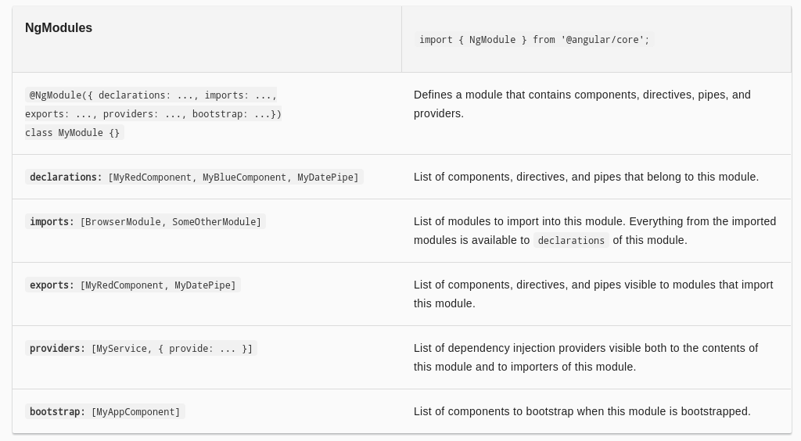

Slide 6
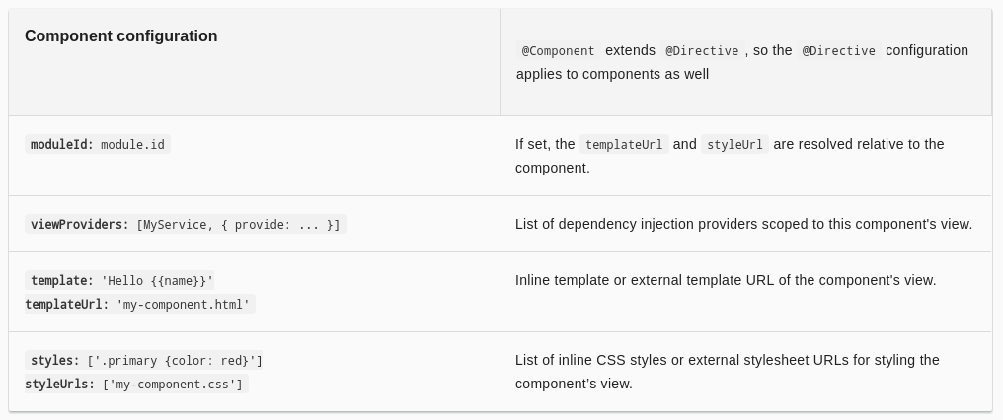

Slide 7
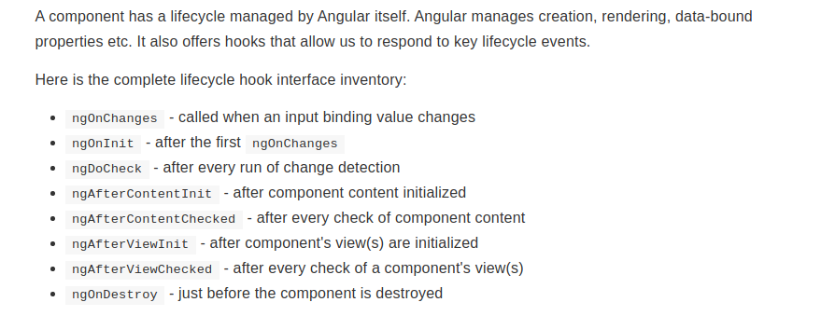
Component Lifecycle

Slide 8
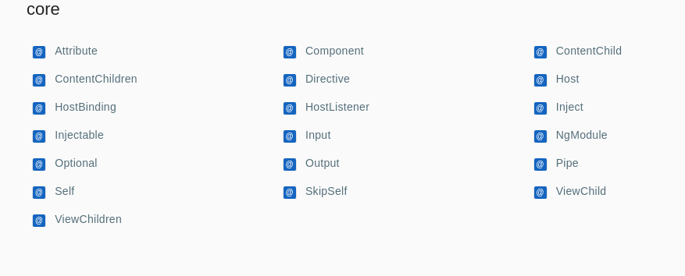
Angular Decorators

Slide 9
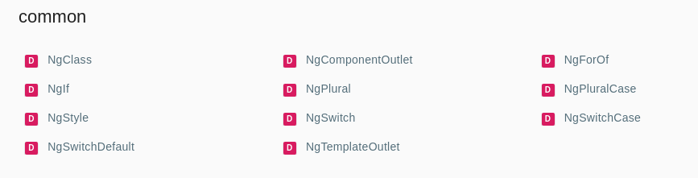
Angular Directives

Slide 10
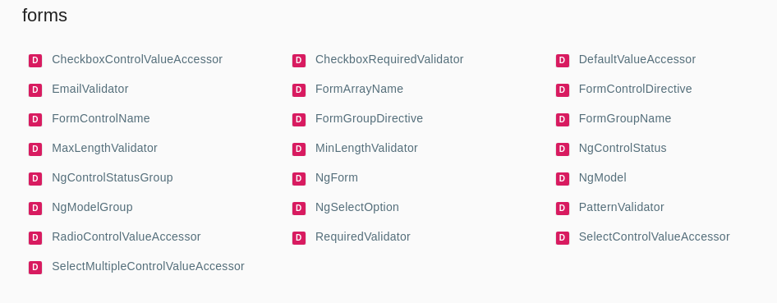
Form Directives

Slide 11
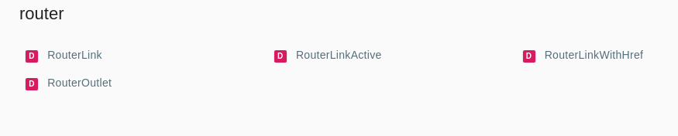
Router Directives

Slide 12
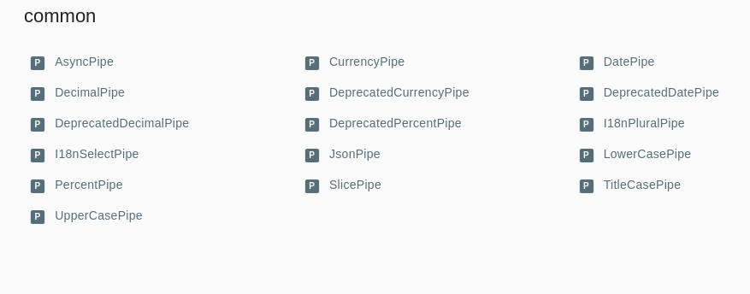
Pipes

